Slide 1

7th Grade Math
Unit 11, Lesson 8 Putting It All Together Volume 2, pg. 187

Slide 2


Benchmarks
MA.7.AR.4.1
Determine whether two quantities have a proportional relationship by examining a table, graph or written description.
MA.7.AR.4.2
Determine the constant of proportionality within a mathematical or real-world context given a table, graph, or written description of a proportional relationship.
MA.7.AR.4.3
Given a mathematical or real-world context, graph proportional relationships from a table, equation or a written description.
MA.7.AR.4.4
Given any representation of a proportional relationship, translate the representation to a written description, table or equation.
volume 2, pg. 187

Slide 3
Integrated Mathematical Thinking and Reasoning Standards
MA.K12.MTR.1.1 Actively participate in effortful learning both individually and collectively.
MA.K12.MTR.2.1 Demonstrate understanding by representing problems in multiple ways.
MA.K12.MTR.3.1 Complete tasks with mathematical fluency.
MA.K12.MTR.7.1 Apply mathematics to real-world contexts.
volume 2, pg. 187

Slide 4

Learning Targets
I can determine if two quantities have a proportional relationship given a real-world context.
I can graph a proportional relationship from a table, an equation, or a written description.
I can determine the constant of proportionality of a proportional relationship.
I can translate a given representation of a proportional relationship to a written description, table, or equation.
volume 2, pg. 187

Slide 5

Warm-Up
volume 2, pg. 188

Slide 6
11.8.1 Warm-Up: Critical Thinking – Shower or Bath?
Some people say that taking a bath uses more water than a shower. Others disagree.
What information would you collect in order to answer the question of which uses more water?
What are some proportional relationships that may be involved in helping to answer this question?
volume 2, pg. 188

Slide 7

Activity
volume 2, pg. 188

Slide 8

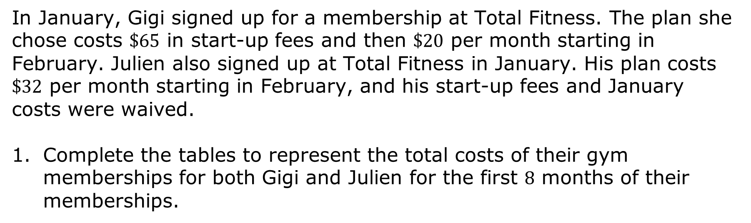
11.8.2 Activity: Station 1 – Gym Membership Plans
In January, Gigi signed up for a membership at Total Fitness. The plan she chose costs $\$65$ in start-up fees and then $\$20$ per month starting in February. Julien also signed up at Total Fitness in January. His plan costs $\$32$ per month starting in February, and his start-up fees and January costs were waived.
Complete the tables to represent the total costs of their gym memberships for both Gigi and Julien for the first $8$ months of their memberships.
volume 2, pg. 188

Slide 9
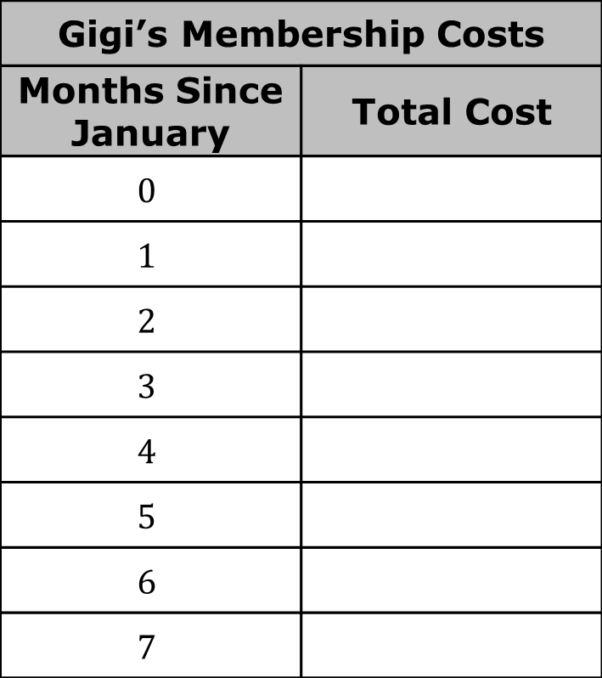
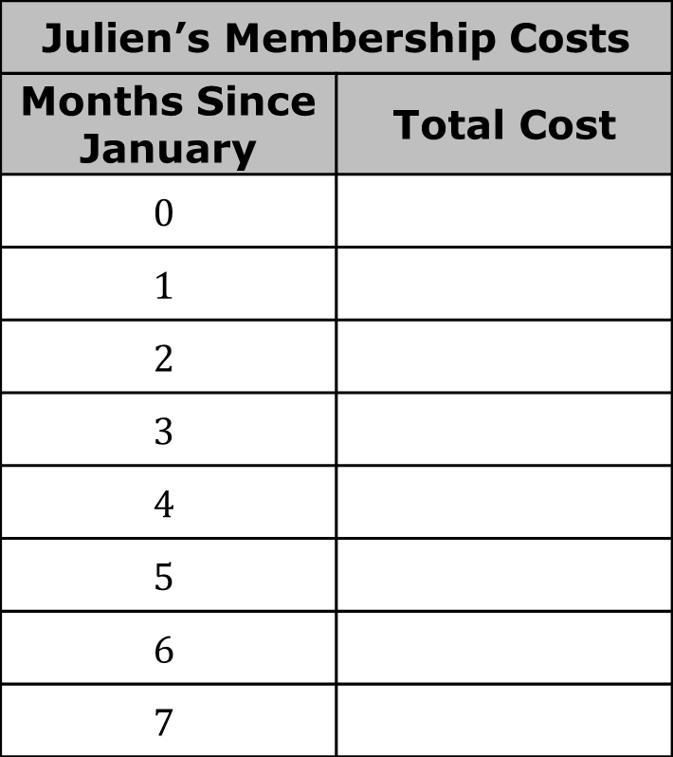
Gigi’s Membership Costs
Months Since January | Total Cost
$$0$$
$$1$$
$$2$$
$$3$$
$$4$$
$$5$$
$$6$$
$$7$$
Julien’s Membership Costs
Months Since January | Total Cost
$$0$$
$$1$$
$$2$$
$$3$$
$$4$$
$$5$$
$$6$$
$$7$$
volume 2, pg. 188

Slide 10

Determine whether either or both gym memberships are a proportional relationship. Then, complete the statements.
Gigi’s membership costs a proportional relationship because _______________________________________________________ ______________________________________________________________
______________________________________________________________.
Julien’s membership costs a proportional relationship because _______________________________________________________ ______________________________________________________________
______________________________________________________________.
volume 2, pg. 189

Slide 11
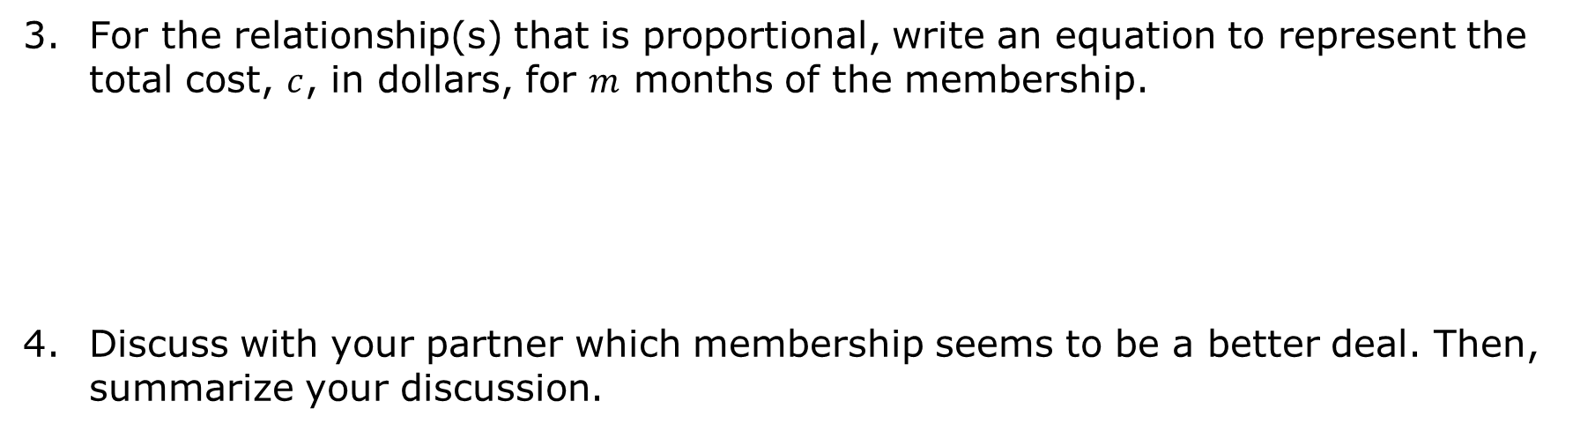
For the relationship(s) that is proportional, write an equation to represent the total cost, $c$, in dollars, for $m$ months of the membership.
Discuss with your partner which membership seems to be a better deal. Then, summarize your discussion.
volume 2, pg. 189

Slide 12
Activity
volume 2, pg. 189

Slide 13
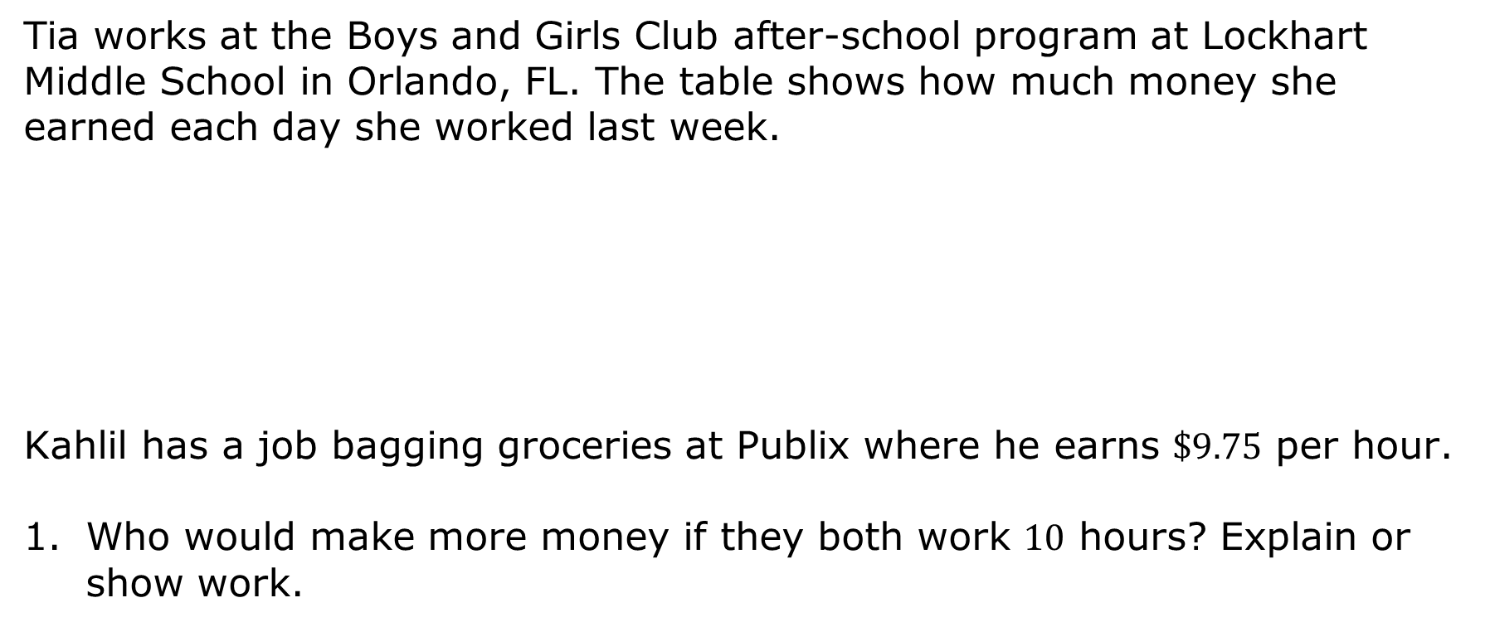
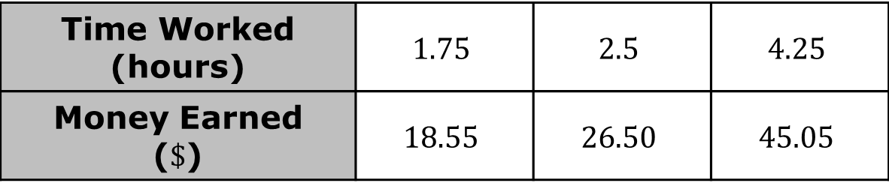
11.8.3 Activity: Station 2 – Who Earns More Money?
Tia works at the Boys and Girls Club after-school program at Lockhart Middle School in Orlando, FL. The table shows how much money she earned each day she worked last week.
Kahlil has a job bagging groceries at Publix where he earns $\$9.75$ per hour.
Who would make more money if they both work $10$ hours? Explain or show work.
Time Worked (hours) | $$1.75$$ | $$2.5$$ | $$4.25$$
Money Earned ($\$$) | $$18.55$$ | $$26.50$$ | $$45.05$$
volume 2, pg. 189

Slide 14
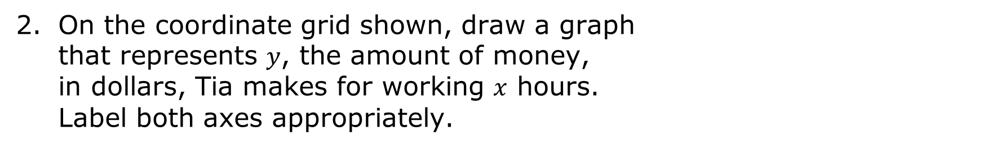
On the coordinate grid shown, draw a graph that represents $y$, the amount of money, in dollars, Tia makes for working $x$ hours. Label both axes appropriately.
volume 2, pg. 189

Slide 15
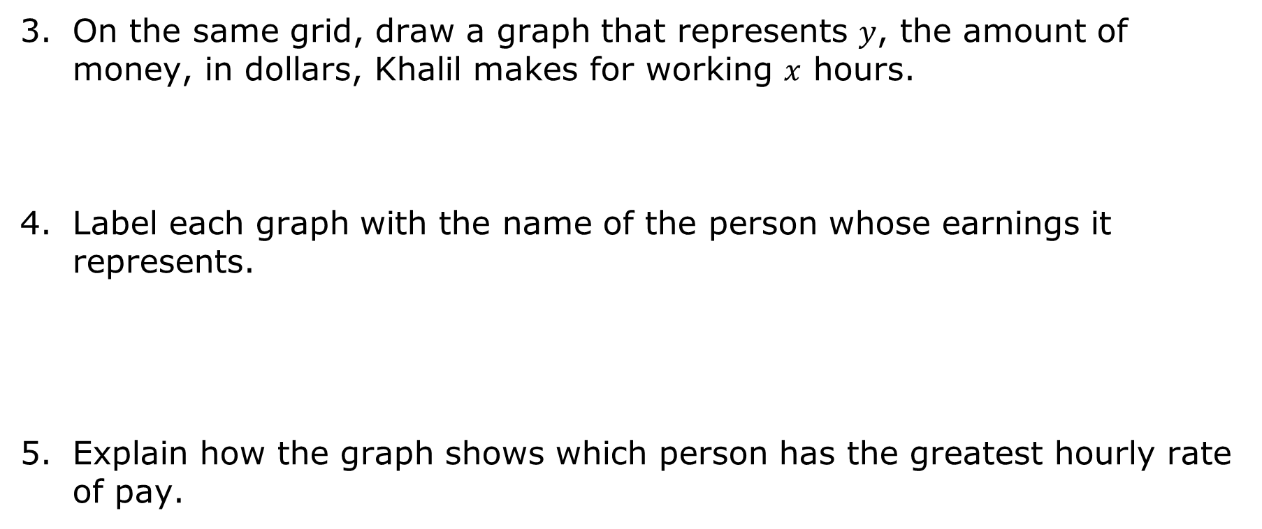
On the same grid, draw a graph that represents $y$, the amount of money, in dollars, Khalil makes for working $x$ hours.
Label each graph with the name of the person whose earnings it represents.
Explain how the graph shows which person has the greatest hourly rate of pay.
volume 2, pg. 190

Slide 16
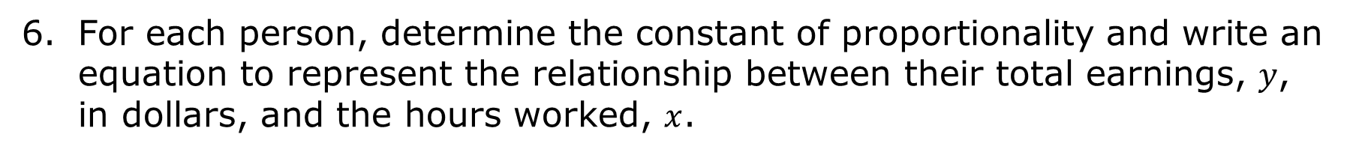
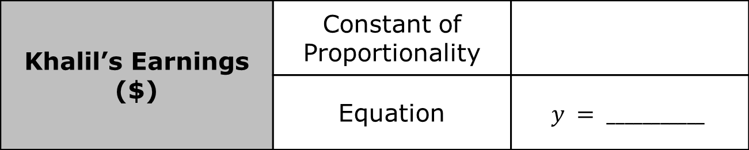
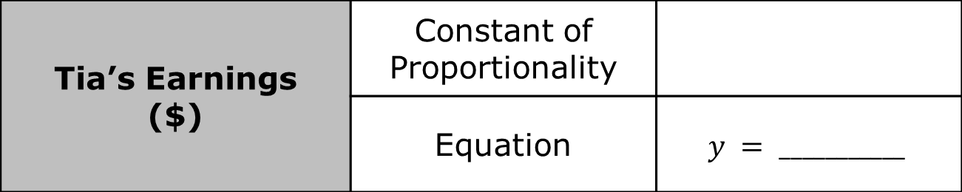
For each person, determine the constant of proportionality and write an equation to represent the relationship between their total earnings, $y$, in dollars, and the hours worked, $x$.
Tia’s Earnings ($) | Constant of Proportionality
 | Equation | $$y = ___________$$
Khalil’s Earnings ($) | Constant of Proportionality
 | Equation | $$y = ___________$$
volume 2, pg. 190

Slide 17
Activity
volume 2, pg. 190

Slide 18
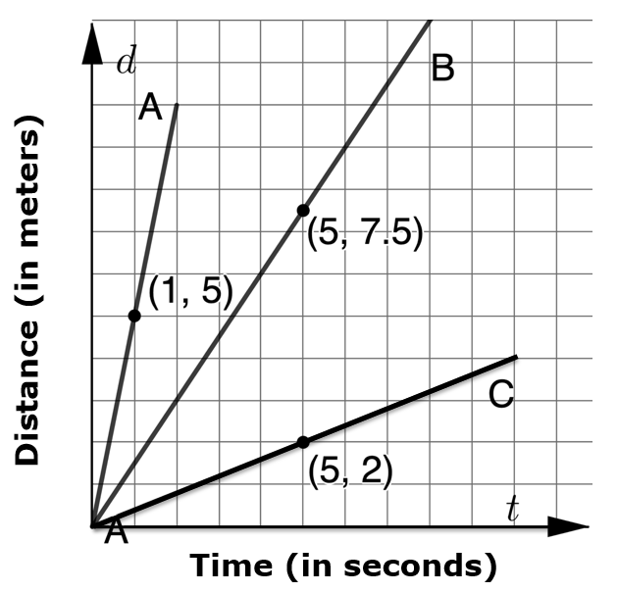
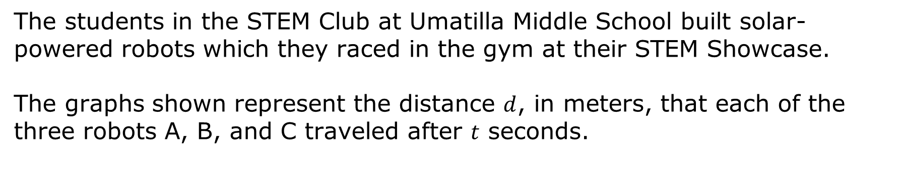
11.8.4 Activity: Station 3 – Robot Races
The students in the STEM Club at Umatilla Middle School built solar-powered robots which they raced in the gym at their STEM Showcase.
The graphs shown represent the distance $d$, in meters, that each of the three robots A, B, and C traveled after $t$ seconds.
volume 2, pg. 190

Slide 19
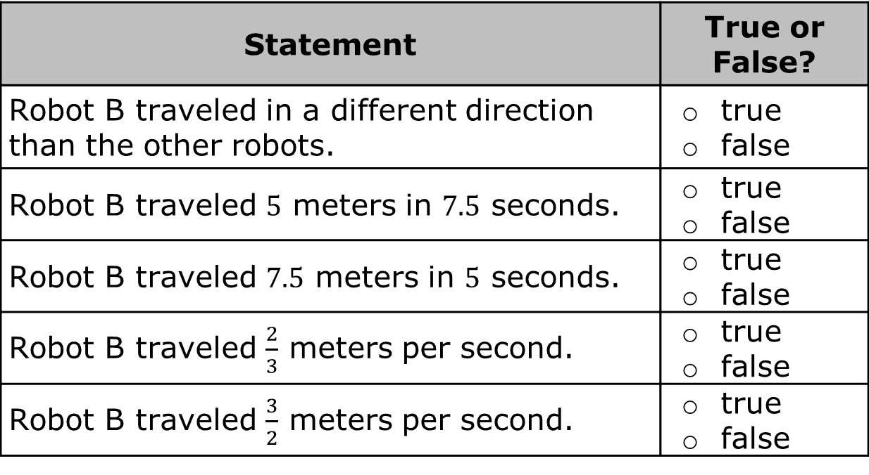
Determine whether each statement in the table is true or false.
Statement | True or False?
Robot B traveled in a different direction than the other robots. | true false
Robot B traveled $5$ meters in $7.5$ seconds. | true false
Robot B traveled $7.5$ meters in $5$ seconds. | true false
Robot B traveled $\frac{2}{3}$ meters per second. | true false
Robot B traveled $\frac{3}{2}$ meters per second. | true false
volume 2, pg. 190

Slide 20

Determine the constant of proportionality, $\frac{d}{t}$, for each robot.
Explain what the constant of proportionality determined for each robot represents in this context.
Write an equation to represent the relationship between distance, $d$, and time, $t$, for each robot.
Robot | Constant of Proportionality
A
B
C
Robot | Equation
A
B
C
volume 2, pg. 190

Slide 21
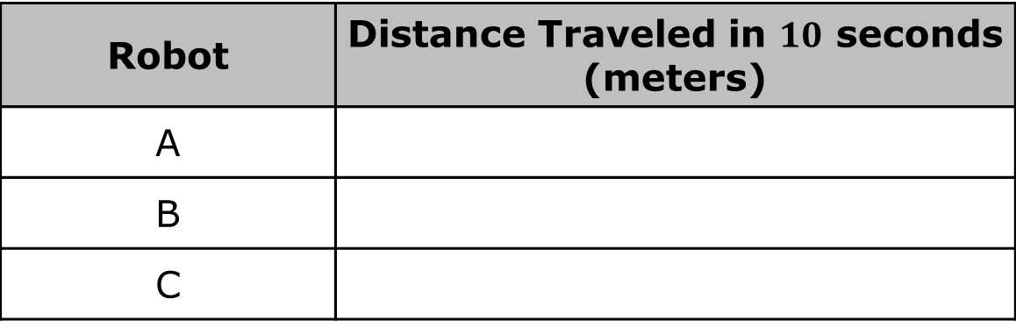
Assume the robots traveled at the same rate for $10$ seconds. How far would each robot have traveled in that time?
Robot | Distance Traveled in $10$ seconds (meters)
A
B
C
volume 2, pg. 191

Slide 22

Wrap-Up
volume 2, pg. 191

Slide 23
11.8.5 Wrap-Up: Reflection
So far in this unit, you have learned multiple concepts about proportional relationships including those listed below.
Determining if two quantities have a proportional relationship
Determining the constant of proportionality of a proportional relationship given a table, graph, or written description
Graphing proportional relationships from a table, equation, or written description
Translating between different representations of proportional relationships
volume 2, pg. 191

Slide 24
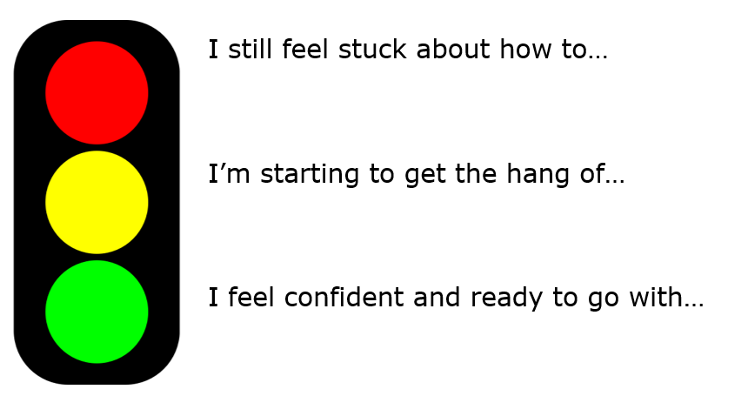
Use the stoplight reflection below to share how you are feeling about each of these concepts at this point.
volume 2, pg. 191

